Slide 1
Nutritional Analyser Using Python and Flask Application
SUBJECT: CLOUD COMPUTING
PROFESSOR:Dr Sukhpal Singh Gill

Slide 2
TEAM MEMBERS
ADINI HEMANJALI – 220721646
AMAN NAREDI - 230290873
BALAJI MP – 231041407
DANIEL RAYMOND - 230452264
SUNANTHA KANNAN - 230841125

Slide 3
OVERVIEW
PYTHON AND FLASK APPLICATION
RESTFUL API
FLASK BLUEPRINT
DATABASE
KUBERENTES
EXTERNAL REST API
SYSTEM ARCHITECTURE

Slide 4
PYTHON AND FLASK APPLICATION
Flask is a lightweight web framework for Python that simplifies web application development. It provides tools for defining routes (web pages), handling user requests, and generating responses.
Flask is known for its flexibility, allowing developers to choose their components and libraries. It's a minimalist framework, which means it provides the basics, and developers can add features as needed. Flask is often used for building small to medium-sized web applications due to its simplicity and ease of use.

Slide 5
RESTFUL API
A RESTful API (Representational State Transfer) is a set of rules and conventions for building web services that enable communication between different software applications over the internet. REST APIs are designed to be simple, scalable, and stateless, meaning each request from a client to the server must contain all the information needed to understand and fulfill the request.
Flask-RESTful is an extension for Flask, a Python web framework, that simplifies the creation of RESTful APIs. It provides tools to define API endpoints, handle HTTP requests (GET, POST, PUT, DELETE), and serialize/deserialize data to/from JSON. Flask-RESTful makes it easier to build scalable and well-structured APIs in Flask-based applications.

Slide 6
FLASK BLUEPRINT
A Flask Blueprint is a way to organize a Flask application into smaller, reusable components or modules. It helps structure your application by grouping related routes, views, templates, and static files together.
Blueprints allow you to create modular and maintainable Flask applications by breaking them into smaller pieces, making it easier to manage large codebases and collaborate with other developers.

Slide 7
DATABASE
Cloud SQL is a fully managed relational database service offered by Google Cloud Platform. It allows you to run and manage popular databases like MySQL, PostgreSQL, and SQL Server in the cloud without the overhead of database administration.
Cloud SQL provides features like automated backups, scaling, high availability, and security, making it easy to deploy, maintain, and scale databases for your applications in the cloud.

Slide 8
KUBERNETES
Kubernetes is an open-source container orchestration platform that automates the deployment, scaling, and management of containerized applications. It provides tools for container scheduling, load balancing, and self-healing, making it easier to deploy and manage applications at scale.
Kubernetes abstracts underlying infrastructure, enabling consistent deployment across different environments and simplifying containerized application management. It has become a standard for container orchestration in cloud-native development.

Slide 9
EXTERNAL REST API
Nutrition Analysis API
Edamam's Nutrition Analysis API extracts nutrition and ingredient data from recipes or ingredient lists quickly. It uses Natural Language Processing to identify food items.
Detailed nutrition information is obtained, including calories, fats, carbs, and more, for each ingredient. It also provides dietary labels like Vegan, Paleo, and Gluten-Free, making it easy to analyze and label your recipes.

Slide 10
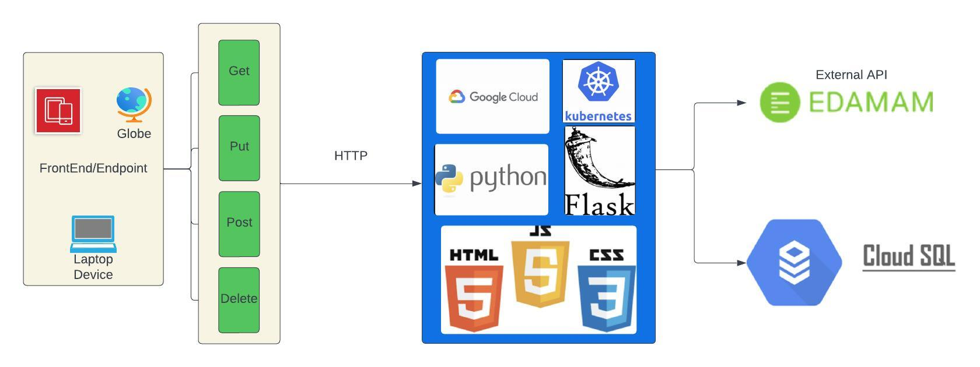
SYSTEM ARCHITECTURE

